Slide 1


January 10th, 2024
1:00pm – 4:00pm
Oregon Conservation and Recreation Fund
Advisory Committee Meeting
Virtual Meeting

Slide 2
Agenda Item 1:
Review and Approve Meeting Minutes
(December 4th, 2023)

Slide 3
Draft Motion Templates re: Minutes
I move to approve the December 4th, 2023 meeting minutes with the continued authority to correct spelling, grammar, and punctuation.
I move to approve the December 4th, 2023 meeting minutes with the addition/correction/ deletion of ____ on page ___, line ____, and continued authority to correct spelling, grammar, and punctuation.

Slide 4

Agenda Item 2:
Guest Presentation: The role of the Ocean Acidification Hypoxia Council and OCRF in Oregon’s changing oceans
Dr. Leif Rasmusen and Jenny Koester

Slide 5
Agenda Item 3:
OCRF Budgeting and 2024 RFP Determinations

Slide 6
Lessons Learned from Past OCRF Solicitations
Positives (+)
Unique funding opportunities
Diversity of grant sizes
Statewide coverage
Efforts to engage with non-traditional groups
Simpler application process than other state programs

Slide 7
Lessons Learned from Past OCRF Solicitations
Room for Improvement (Δ)
Focus investments on habitat protection and restoration priorities | More outreach and engagement needed with non-traditional or underserved communities to encourage them to apply
Clarity needed on OCRF’s funding priorities for recreation | Need to expand criteria to ask applicants more about how they are addressing diversity, equity, and inclusion
Difficult to fund research and monitoring projects with the $50,000 cap | Need some high-profile, high-impact projects to showcase the drought package funding
Difficult to fund larger-impact habitat restoration projects with the $50,000 cap, given inflationary increases in costs | Need greater clarity the applications to describe the proposed work that will be accomplished to reduce assumptions being made by reviewers
State agency bureaucracy, insurance requirements can be daunting to smaller, newer organizations

Slide 8
What stays the same in the Jan 2024 RFP
$1 million offering, 20 projects max, as per usual
Still favoring drought-related projects
Still prioritizing smaller projects ($50,000 or less) because we still want to support small, new, or non-traditional organizations and projects

Slide 9
Proposed Improvements for Jan 2024 RFP
Raise project cap to $140,000
  Projects seeking this level of funding must address drought and have a significant, measurable impact/benefit
Enhanced application questions
  Grant receipt history: Have you previously received grants aside from OCRF? What was the $ amount of the largest grant you have received? Who was the granting agency?
  How does your project align with the KCI's, goals, and actions in the Oregon Conservation Strategy?
Re-work application questions around Project Goals, Tasks/Deliverables
Enhanced measures of Outdoor Equity – going beyond yes/no answers

Slide 10
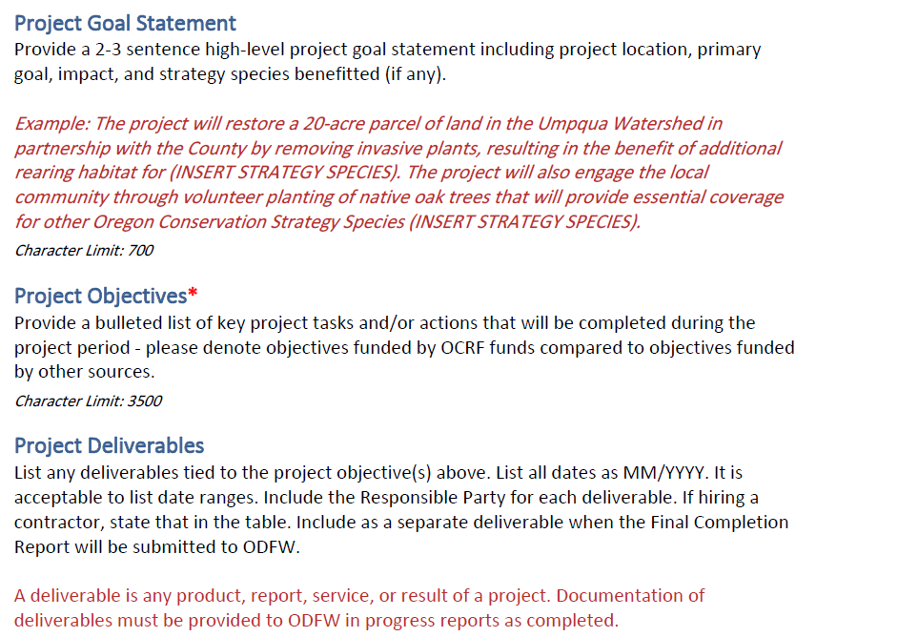

Slide 11
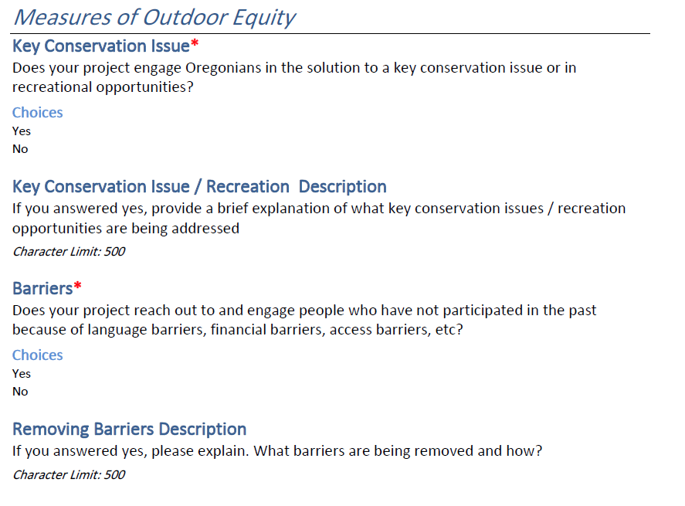
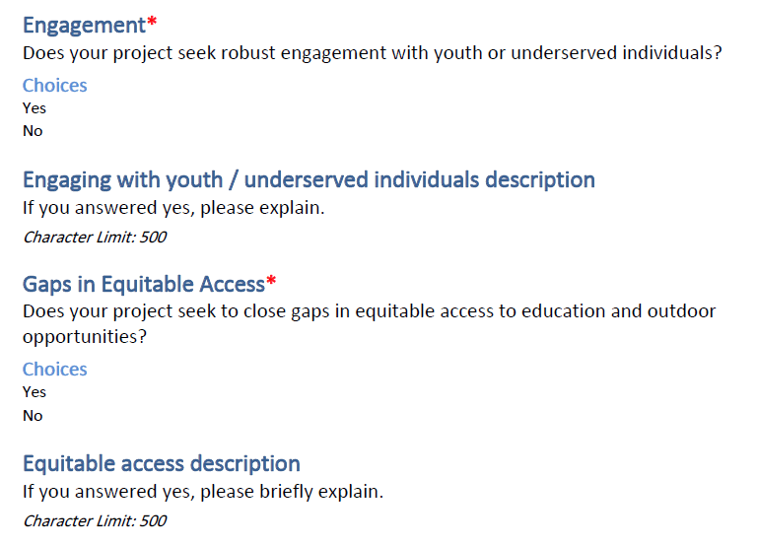

Slide 12
Draft Motion : Funding Cap Raise
I move to approve raising the funding maximum for the OCRF Spring 2024 Grant Cycle up to $140,000.
I move to approve raising the funding maximum for the Oregon Conservation and Recreation Fund Spring 2024 Grant Cycle up to $(Insert other funding cap here).

Slide 13
Agenda Item 4 :
Break
(Please be back in 10 min)

Slide 14
Agenda Item 5:
OCRF Spring 2024 Grant Solicitation

Slide 15
OCRF RFP Timeline - Spring 2024
Request for Proposals (RFP) – Open January 30th, 2024
Official RFP Guidance made public (remains open for 60 days)
Informational Session – February 10th, 2024
(Recording to be posted on website)
Week of Reminder of grant closure – March 18th, 2024
Request for Proposals (RFP) – Closes March 26th, 2024
Application must be received by 11:59pm
Technical Review Period – March 27th to April 24th, 2024
OCRF Advisory Committee Review Period – April 25th to May 23rd, 2024
OCRF Advisory Committee Recommendations – June 4th, 2024
ODFW Commission Voting – June 14, 2024
Release of funds following contracting process – August 2024

Slide 16
OCRF Program Updates
Foundant: Built out for the OCRF program, will be used for next RFP
  New Advisory Committee review platform (create account)
Northern Basin & Range Seat: Has been filled! Welcome Jim Hammett
December 15: OAR Revisions approved by the ODFW Commission.
Notes:
Conducted outreach, and OCRF representation at the Oregon outdoor recreation programs, trail alliances, Diversifying the pool of applicants that apply to OCRF. Hopefully this helps address the

Slide 17
OCRF Meeting Schedule 2024
~Moving to First Tuesdays of the month for 2024~
Jan 10: Spring RFP considerations / determinations, OAH Council
Feb 6: Review Draft of Strategic Plan
Mar 5: Review Final Draft of Strategic Plan / Scoring Considerations

Slide 18
Agenda Item 6:
Public Comment

Slide 19
Agenda Item 7:
Meeting Wrap-up

